Slide 1

Data Structure Fundamentals
28-12-2021

Slide 2
Objectives
Introduction to Data Structure
Basic concepts of Data structure
Types of Data structure
Array
Multidimensional Array and String
Link List
Stack
Queue

Slide 3

Analogy for Understanding of Data Structure and Algorithms
In general life, consider the example of making tea.
What we will require to make tea.
Ingredients
Procedure to follows
Similarly, While comparing this scenario with respect to data
Structure, we will have to keep two simple things in our mind.
Data structure → This is nothing but way to arrange data for
Efficient use of memory.
Algorithms → Steps to follow to accomplish any task.

Slide 4
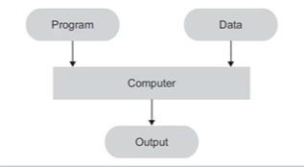
Introduction to Data structure
How does computer is going to process any program or application.
Key points →
In computer science, Study of data, it’s representation and it’s processing is very Important.
The success or performance of application or computer program is depends on representation of data and choosing correct algorithm.
We can say , Data structure is organizing data elements and interrelationship among them.

Slide 5
Why we need data structure?
Program design depends on crucially on how data is structured for use by program.
So we should know implementation of Data structure because of following reasons.
To make implementation of some program easier.
To speedup performance of any program or application.
To manage memory usage.
To let debug code easily.

Slide 6
Basic Terminologies in Data structure
(ADT) Abstract data type.
Mathematical description of an object with set of operation on object. Useful in building block.
Algorithm
A high level, Language independent, description of step by step process.
Data structure
A specific family of algorithm for implementing an abstract data type.
Implementation of Data structure
A specific implementation in specific programming language.

Slide 7
Data
Data → It is nothing but just piece of information
Data could be categorized in two types.
Atomic Data → Atomic data is the data which considered as a single, non-decomposable entity
Example: integer 43234 is considered as single integer value.
Composite Data → Composite data can be broken down into subfields that have some meaning
Example: Mobile Phone number +91-123456755, which is compose of Country code as well as phone number.

Slide 8
Data type
Data type refers to kind of data a variable may store.
Data types widely categorized in two types.
Built-In Data Type → Most of programming languages have their own in built data type
Example → int, float, char and many more …………..
User defined Data Type → User can define his or her own data type, called as user defined data type.
Example → structure union and classes.
Class is the best example of User defined data type.

Slide 9
Data Object
Data object represents a container for data values. It is nothing but a place where data values would be saved and could retrieve later.
Data object is runtime instance of data structure.

Slide 10
Data structure
Data structures refer to data and representation of data object within program, which means implementation of structured relationship.
Data structure is collection of atomic and composite data type in a set with defined relationship.
The best suitable definition for Data structure is Organizing data, Managing data and store the data in appropriate format so that data could be access and modify efficiently.

Slide 11
Data structure as DFA
DFA stands for Domain, Function and Axioms.
Domain: This is the range of values that the data may have.
Function: This is set of operation for the data. We will have to implement set of instruction for data structure to operate on it.
Axioms: Axiom is nothing but set of rules with which different operation belonging to function can actually be implemented.

Slide 12
Abstract data type
ADT is a mathematical model that includes data with various operation defined
Implementation details of an ADT are hidden, therefore it is called as Abstract.
To represent mathematical model underlying an ADT, we use Data structure.
For best understanding of ADT, keep two things in mind.
What → What is required output
How → To achieve this how does we can implement data structure.
Example :- If you will have to develop a queue of data then we can implement it using any of most relevant concept of data structure like Array, Linked list or any other choice.

Slide 13
Types of Data structure.
Primitive and Non-Primitive.
Linear and Non-Linear
Static and Dynamic
Sequential Access and Direct Access.
Persistent and Ephermal

Slide 14
Primitive Data Structure
Primitive data structures are the predefined types of data that are supported in the programming language.
These fundamental data types of the language. For example Integer, Character, String.

Slide 15
Non-Primitive Data structure.
The non-Primitive data structure are created with the help of primitive data structure. Non-primitive data structures are more complicated than primitive data structure but highly useful
The non-primitive data types are those defined by programmer.
They are further classified in as Linear and nonlinear data types.

Slide 16
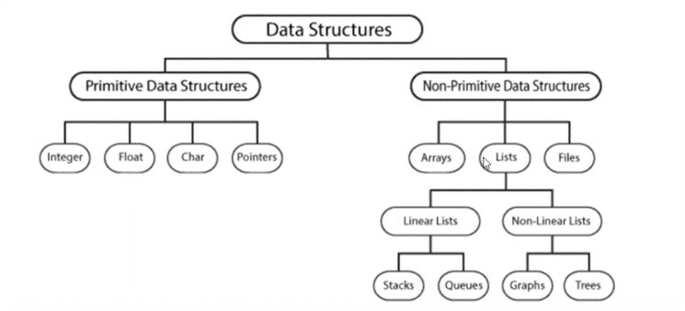
Primitive and Non-Primitive

Slide 17
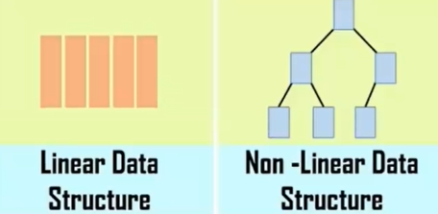
Linear Data structure
Data structure is said to be linear if it’s elements form a sequence or linear list.
Linear Data structure, every data elements has unique successor and unique predecessor.
Example of Linear structure are array, stack, queue, linked list.

Slide 18
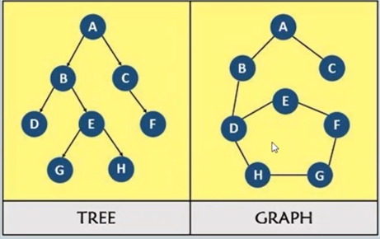
Non-Linear Data structures
In Non-linear data structures, every data element may have more than one predecessor as well as successors.
Elements don not form any particular linear sequence.
Example of Non-Linear Data structure are tree, Graphs.

Slide 19
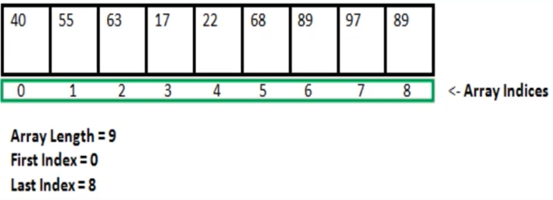
Static Data structure
In static data structure, size of structure is fixed. The content of Data structure can be modified but without changing the memory space allocated to it.
Example: Array is best example of Static Data Structure.

Slide 20
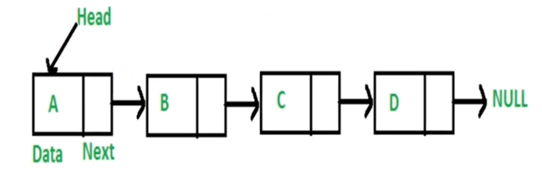
Dynamic Data Structure
Dynamic data structure, the size can be randomly updated during run time which may considered efficient with respect to memory complexity of the code.
Dynamic data structures are flexible
Example : Link List.

Slide 21
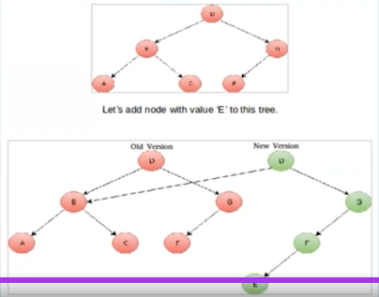
Persistent and Ephemeral Data Structure
Persistent Data structure is the data structure which always preserve it’s previous version when gets modified
Ephemeral Data structure gives only recently modified version

Slide 22
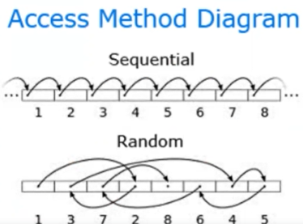
Sequential Access and Direct Access
Sequential Access : Sequential Access must begin at the beginning and access each element in order, one after another.
Direct Access allows the access of any element directly by locating index or address.

Slide 23
Array
Array is a sequential and Linear data structure. It is use when there is requirement of storing data of same type.
Consider a scenario where we will have to save score of 100 Students.
If we will have to store group of data together in a sequential manner in computer’s memory then Array is could be choice.

Slide 24
Array
An array is a finite ordered collection of homogeneous (same type) data elements which also provides direct access or random access to any of it’s element.
An array as a data structure is defined as set of pair(index, value) such that with each index value is associated.
Index → Indicates the location of an element in an array
Value → Indicate the actual value of that data element.
In array , there is only one successor as well as predecessor so it’s also called as linear data structure.

Slide 25
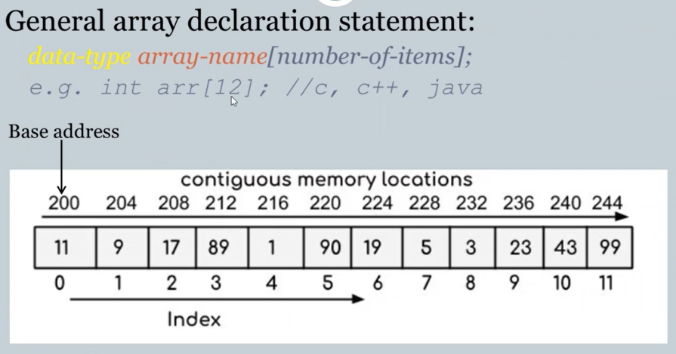
Array

Slide 26
Characteristic of Array
An array is finite ordered collection of homogeneous data elements
In array successive elements of list are stored at fixed distance apart.
Array defined as set of pair(index and value)
In array insertion and deletion of element in between position requires data movement.
Array provide static allocation which means space allocation done once during compile time, can not be changed run time.

Slide 27
Advantages of Array
Arrays permits efficient random access in constant time.
Arrays are most appropriate for storing fixed amount of data.
Wherever there is a direct mapping between element and their position , array becomes best choice.

Slide 28
Disadvantages of Array
Array provides static memory management therefor during execution the size can neither be grown nor shrunk.
Array is not good choice where often operations are insertion and deletion because need to do lots of data movement.

Slide 29
Two-dimensional Array & String
Two-dimensional array consist of both rows and column.
General declaration as follow:
Data type array_name[number of rows][number of columns]
Example – int arr[3,3];
Individual elements of array can be accessed by specifying name of the array and element's row and column indices.

Slide 30
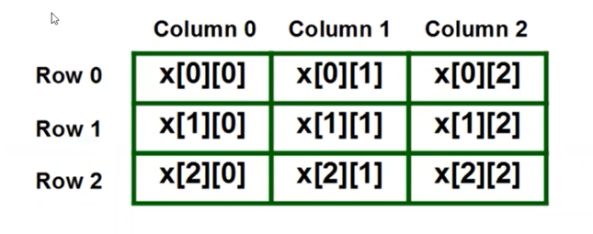
Initialization of Array and it’s structure.
Arrays can be initialized at the time of declaration
Example: int matrix[3][3]={{35,23,12},{21,12,43},{23,12,32}};
The compiler fills the array row by row.
By using proper combination of index for row and column we can access required data element. So we can access sequentially as well as directly.

Slide 31
String
String is fundamental concept.
In most of programming languages, There are special classes present to do String manipulation.
For String manipulation we also have many in built function.
Example: for getting length of any String we have length function.

Slide 32
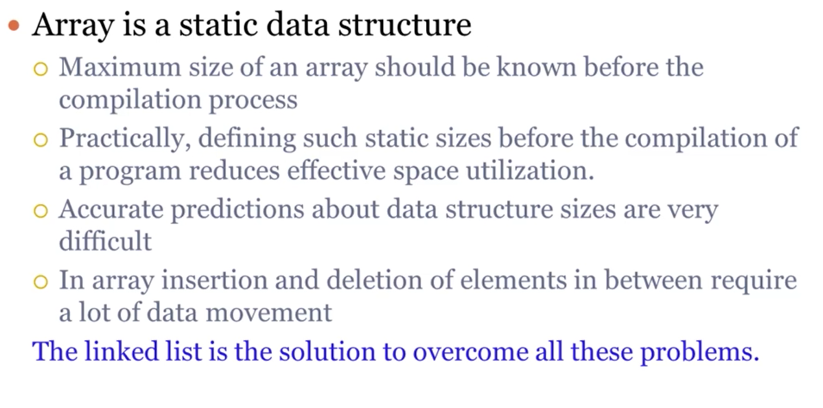
Link list
Let’s recap disadvantages of Array first.

Slide 33
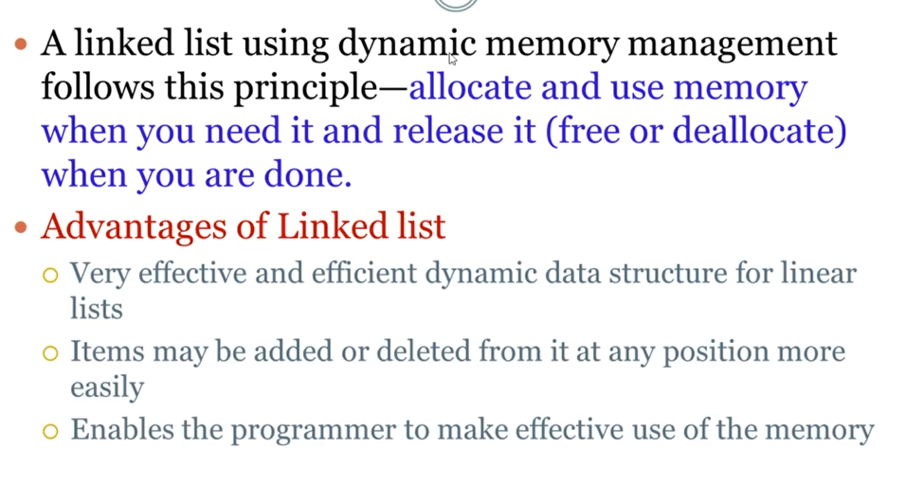
Link List

Slide 34
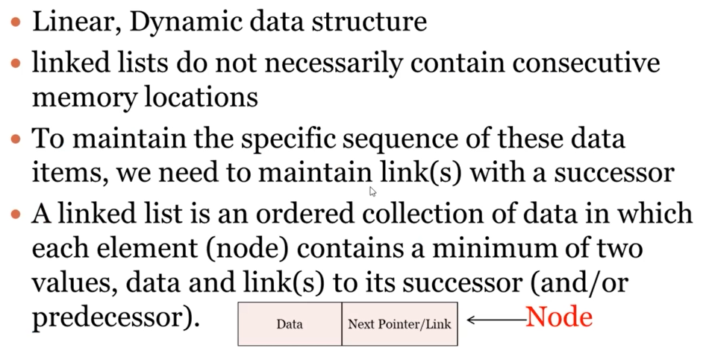
Link List

Slide 35
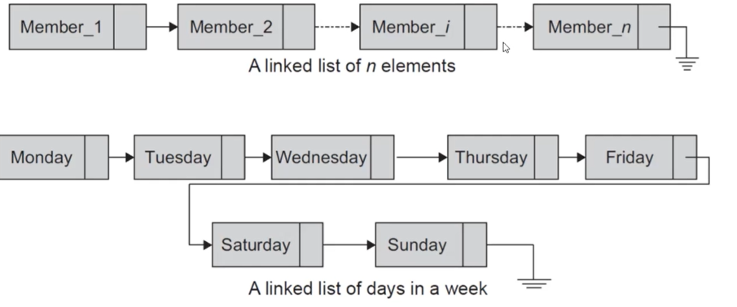
Link List workflow

Slide 36
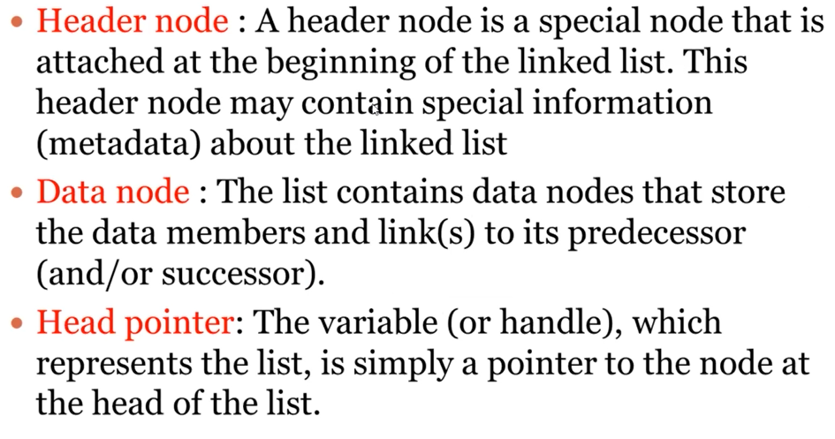
Terminologies of Link List

Slide 37
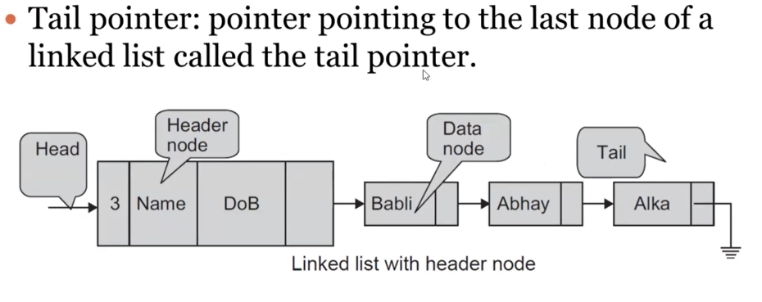
Terminologies of Link List

Slide 38
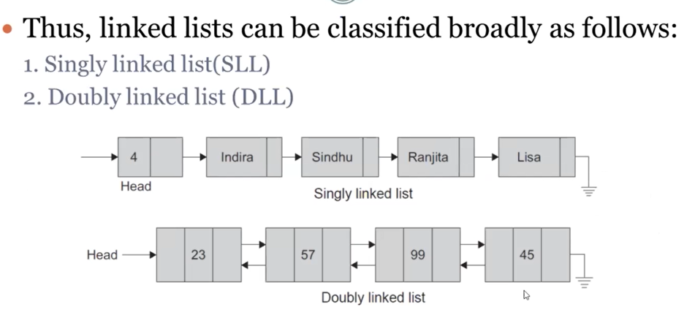
Type of Link List

Slide 39
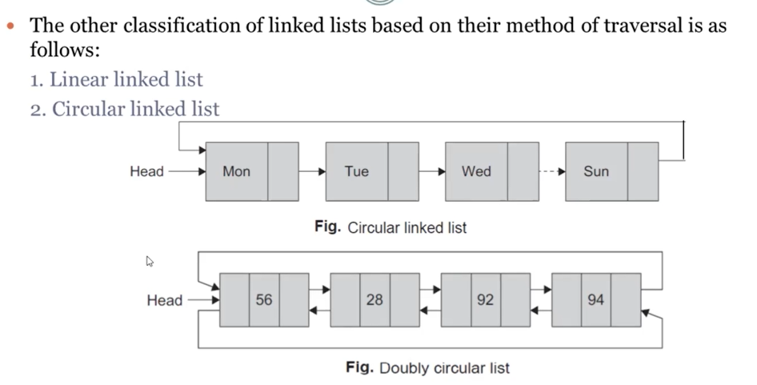
Type of Link List

Slide 40
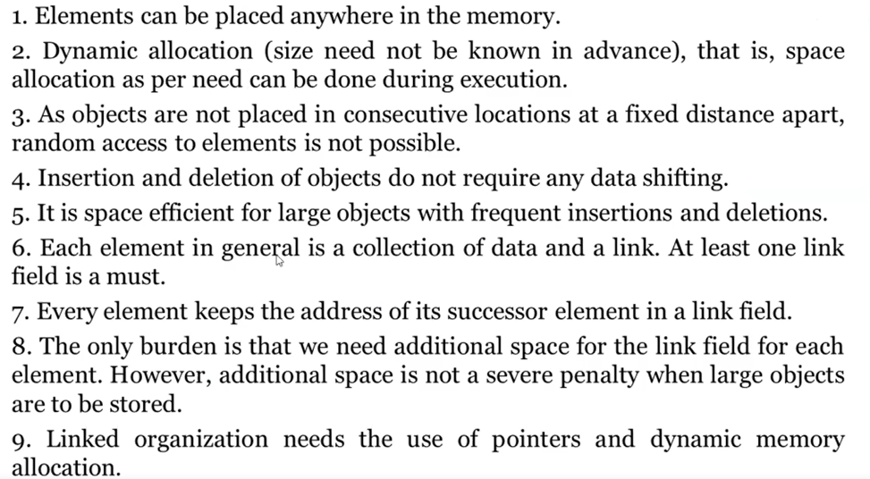
Benefit of Linked List

Slide 41
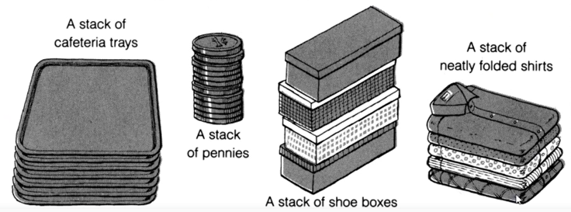
Stack Analogy

Slide 42
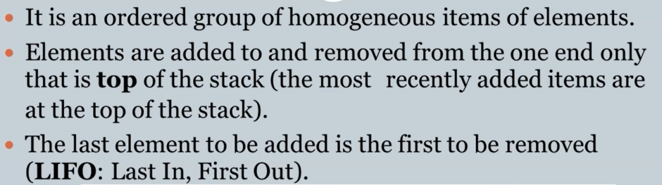
Stack

Slide 43
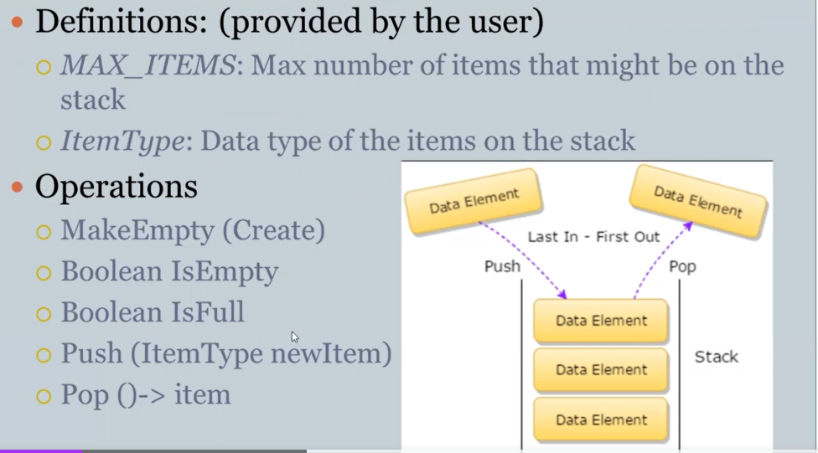
Stack

Slide 44
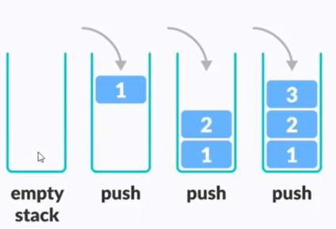
Push Operation
It’s a function use to add new data element to top of stack
Preconditions : Stack should be initialized and wouldn’t be full
Postcondition: New Item can be added on top in stack.

Slide 45
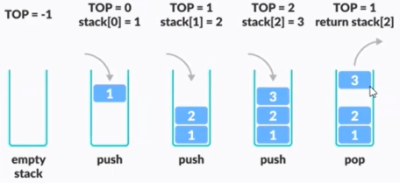
POP Function
It is a function which is use for removing top item from stack.
Preconditions : Stack should be initialized and wouldn’t be empty
Postcondition: Top element from stack would be removed..

Slide 46
Problem with Stack
Stack Overflow:
When we are going to push element in stack which is already full in such cases Stack Overflow scenario will occurs.
Stack Underflow:
This condition occurs when stack is empty and we are going to pop element.
(We can implement Stack either by using Array or Linked List)

Slide 47
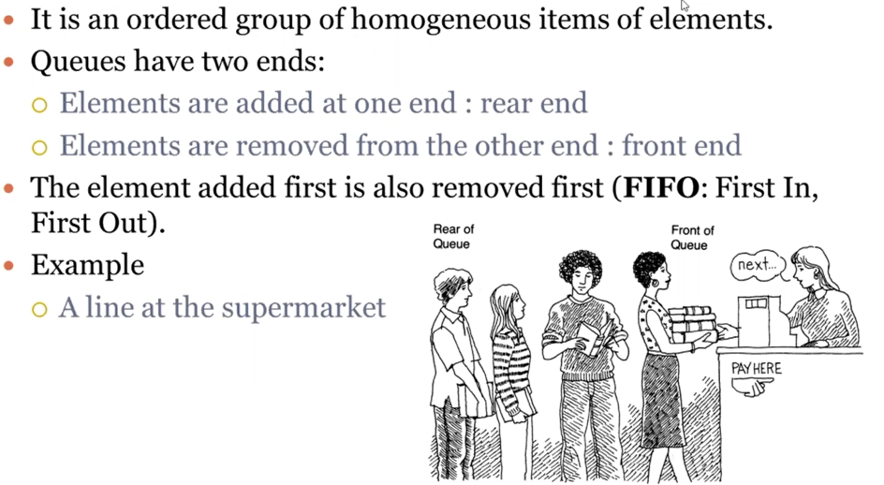
Queue

Slide 48
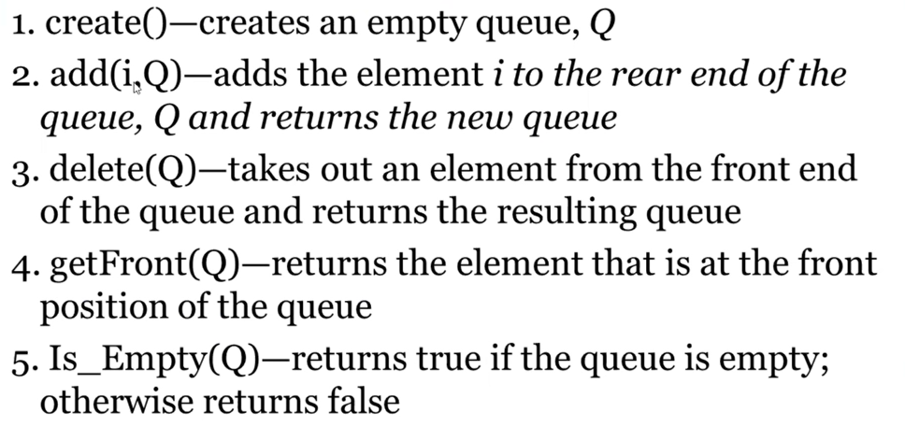
Queue

